Slide 1











Slide 2
Pillars of Agile BI The journey to high performance BI Development
@Jbosems donedifferent.data.blog
Notes:
Introduction on myself, my work at Inmeta Consulting and how I came to this field
What this lecture is about, setting up a framework of important pillars in developing BI solutions in an Agile way
What this lecture is NOT about, this is not an ultimate answer and will probably develop over time
1:50

Slide 3
Pillars of Agile BI
6 elements of developing effective BI solutions
Notes:
What are we going to discuss
Agile Mindset
Accessible Prototyping
Isolatable Deliverables
Live Docs
TDD/BDD
The Development Process
3:50

Slide 4

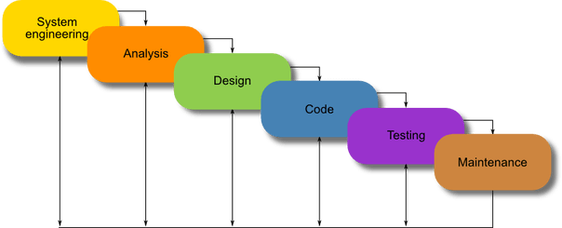
Pillars of Agile BI
What is Agile?
How did we work in the yesteryear?
Notes:
Explain what Agile Development is
Seperate the methodologies from the actual agile principles
Main differences between how we used to develop before
Prince2 assumes a more of a hierarchical top down structure where the manager knows best and oversees all.
Common was a waterfall practice where all the phases of the project where seperated
Agile has a bottom up structure and assumes personel knows best what they need and what they can predict
Waterfall was replaced with iterative process
6:00

Slide 5
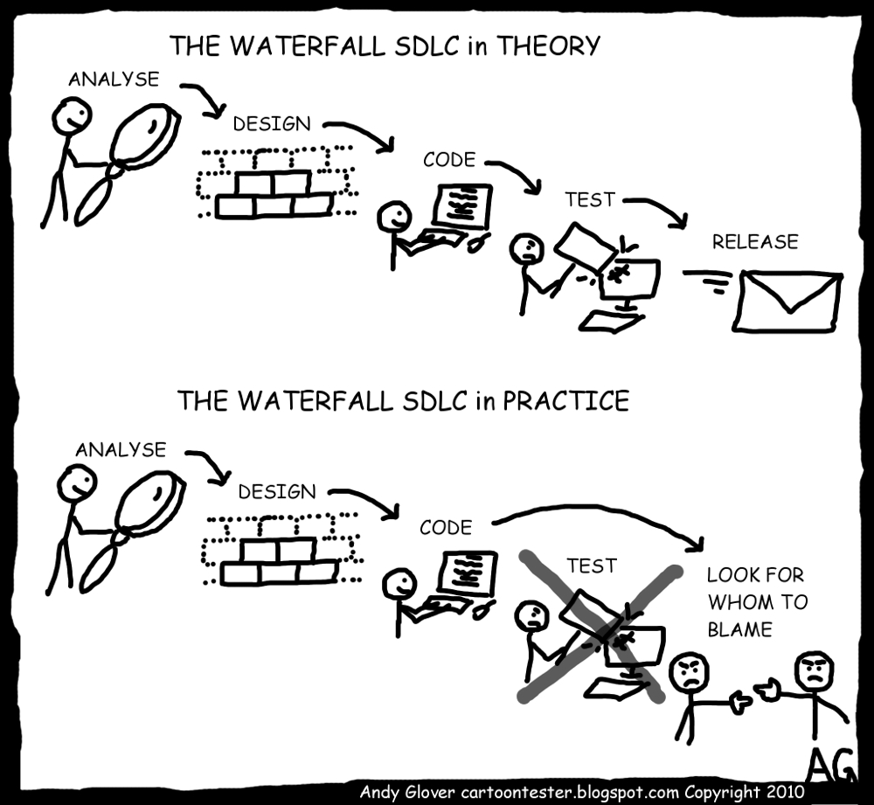
Pillars of Agile BI
Why was this a painful process?
Notes:
IT projects are highly volitile and are subject to changing requirements
It is very rare for business users to actually know what they want until they are faced with the actual application
By pre planning everything change is not part of the process
By promising big and early AND with a certain deadline the risk of wrong estimation is high
Managers were often not technical enough to make the assessments leading to discrepencies between what the manager thought they could report vs what could actually be reported
8:15

Slide 6
Pillar 1: Agile Mindset
Pillar 1: Agile Athletics What is the Agile Mindset?
Notes:
Why i start off with an agile mindset, and why an athletic vision is mandatory for any agile success
We need a common set of beliefs so that we share our common dot on the horizon
What is the exact agile mindset
Defining common goal, constant willingness to improve, etc
Being an athlete in IT development
9:55

Slide 7

Pillar 1: Agile Mindset
Why do we start our journey here?
Notes:
Athleticism requires taking some degree of ownership of everything that influences your results
Jocko Willink story about starting his own publication company to release the book for his daughter
We learn from this that even if something is outside your responsibility, there is no value in playing the blame game
12:35

Slide 8
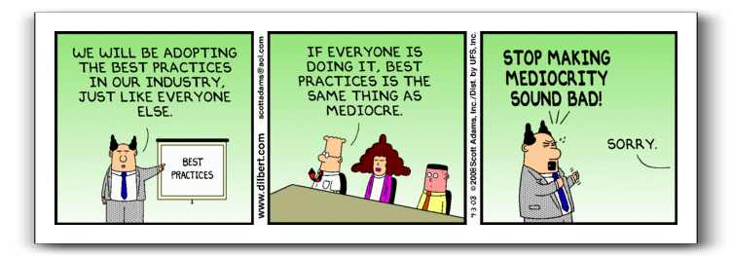
Pillar 1: Agile Mindset
So why is this an explicit skill we need to develop?
Notes:
It’s the same question as why isn’t everyone a pro athlete, why isn’t everyone top university professor
Why isn’t the entire SQL community at these congresses?
People’s willingness for sacrifice, including their sacrifice of Energy for something that is not certain to deliver a result
People are vastly different in their level of ambition, and Agile demands ambition.
14:05

Slide 9
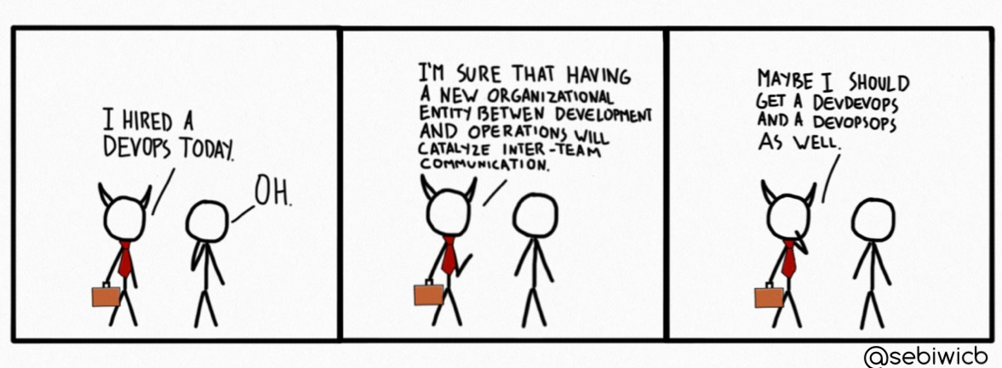
Pillar 1: Agile Mindset
Our goal: Dev-Ops
The MLG of Software Development
Notes:
Ownership of not just a process, but an entire value chain
Requires both business, and testers, and deployment, and development to be in the same team
When there is a problem EVERYONE is responsible for the solution
Dev-ops teams have little to no reliance outside the team for their deliveries so issues are always in the team
Dev-ops teams are self managed, so managers are in service of the employees, not the other way around
Deliveries are done often so that risks are small and fixes are relatively easy
Dev ops seems like the most fun approach but often during critical issues you lose your sleep until the fix is in productio
There is no work life balance, your work is top priority
15:505

Slide 10
Pillar 2: Accessible Prototyping
Pillar 2: Accessible Prototyping (AP)
Notes:
Explain that Accessible prototyping means that you are building prototypes that have a low entry of modifying for the end user
A prototype in this sense can be a mockup or it can be a very basic form of the final product
Stating that it’s important since it lowers the risk of creating something that the business did not request
Don’t work with business stakeholders, work with assigned ambassadors of your stakeholders. These are not managers, these are «first among equals»
17:55

Slide 11
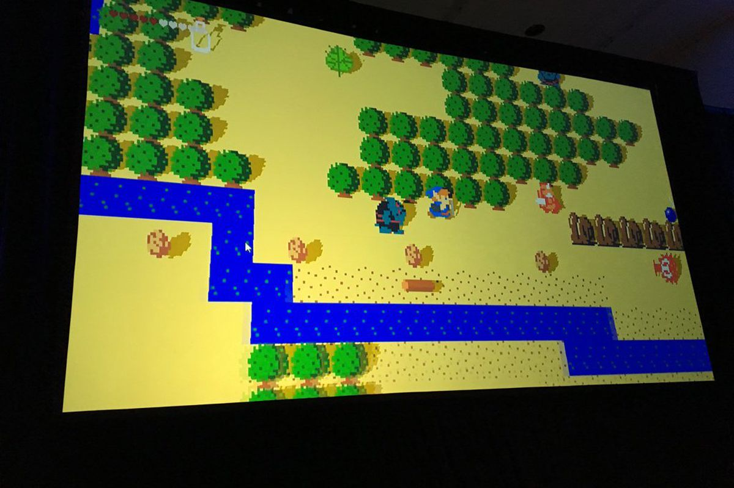
Pillar 2: Accessible Prototyping
How does this relate to the Agile Mindset?
Notes:
What is this picture? (everyone will say zelda for the NES)
Nope, it’s a prototype for Breath of the wild
How making something concrete and tangible allows users to interact with a solution before it’s there
Sharing responsibility with business users, if the prototype is approved the business has comitted to this form of the final prodoct
19:55

Slide 12
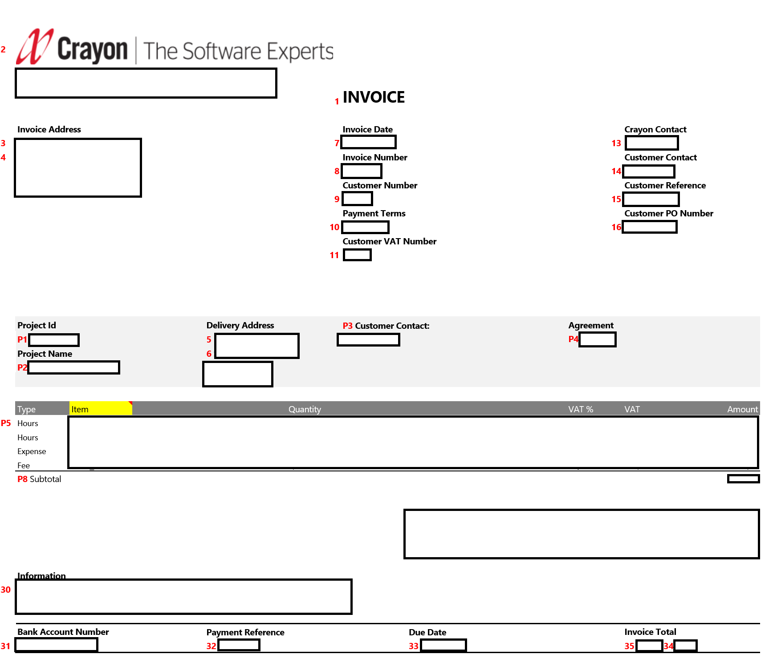
Notes:
Explain why reporting is so easily prototypable
Explain why the use of Excel is so useful to do these kinds of things
Talk about that every field is detailed in other pages (formulas etc) and that this format of documentation allows for a constant updating before the product goes live
More on that later
21:55

Slide 13
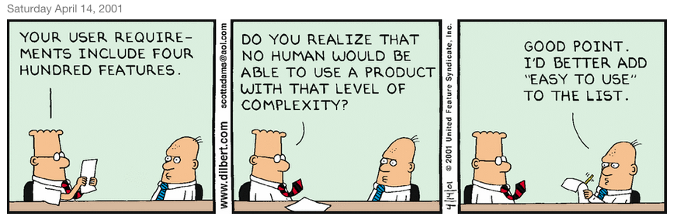
Pillar 2: Accessible Prototyping
What is different between a PoC and a PoV?
Notes:
Explain how a proof of concept is often a first step
Mention the limits of a proof of concept, and that before being able to use it very often there needs to be some rebuilding
Proof of value focusses on delivering one value stream that the business can already start using, and on which to expand on next iterations
24:10

Slide 14
Pillar 3: Isolatable Deliverables
Pillar 3: Isolatable Deliverables (ID)
Notes:
Explain that BI developments often take long because they deliver an entire value chain in one og
Explain that testing is an issue due to this same situation
Note that in other domains we use microservices and that BI would be helped if we can add these principles
26:30

Slide 15

Pillar 3: Isolatable Deliverables
Inverse Engineering (IE) in combo with ID
Notes:
Explain that inverse engineering is pretty much looking at your goal and then going back from there
This means that you don’t set up infrastructure yet where this is not needed for the PoC or PoV (and as such if a power BI report requires one source you will only access one source)
Since you take the business value as a first you limit the amount of deliverables you give, and as such you isolate requirements more
29:00

Slide 16



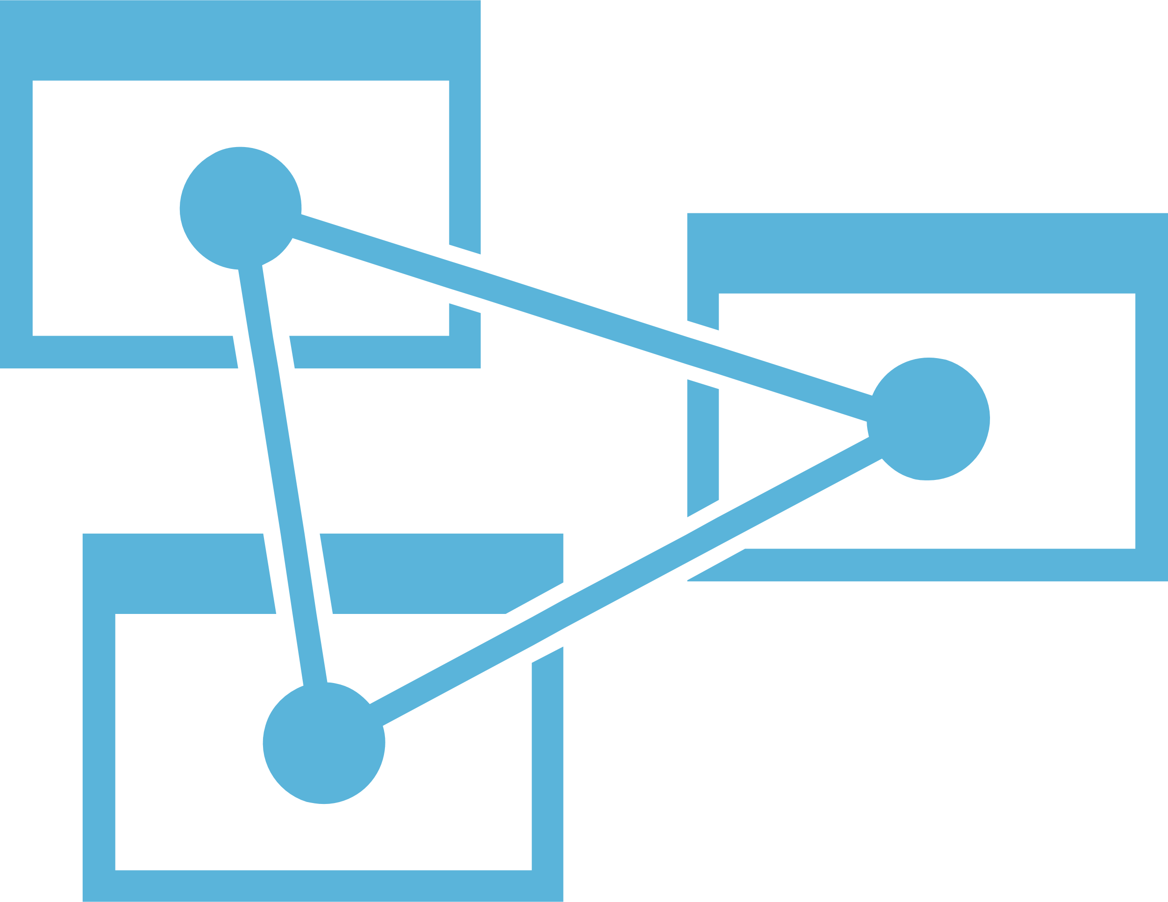





Source
Retention
Integration
Preperation
Presentation
Technical
Business
Notes:
Explain that this would be the ideal situation since we would be able to deliver each layer
Note the value that we can deliver to end users on every layer
Explain the seperation of technical solution and business layer
Notify especially that every seperate layer should have a business value and should provide as a result a «consistent» dataset
Explain that this thought experiment works best if you imagine a team of 50 people would deliver this project, all in different locations (customer - supplier relation)
32:00

Slide 17
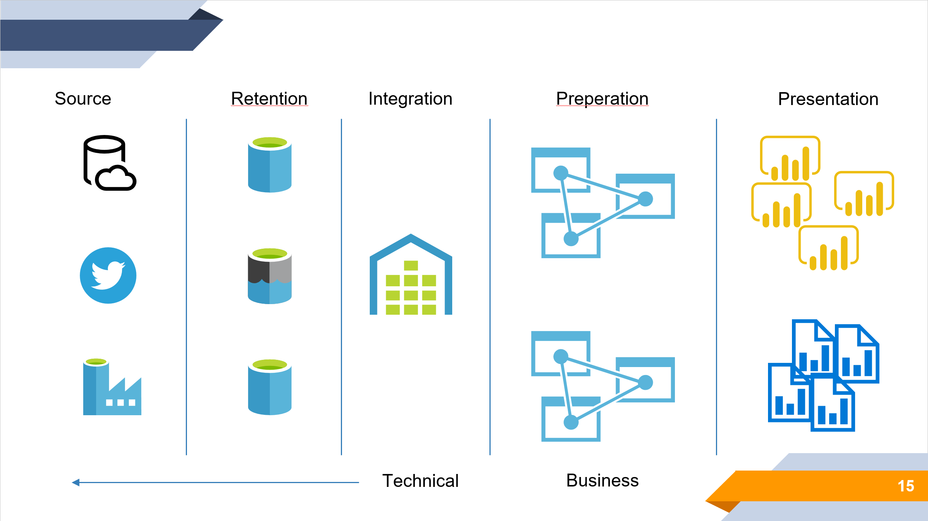
Pillar 3: Isolatable Deliverables
Why does this help us implementing BI?
Notes:
Name the added values from a technical perspective, making changes on a technical level easier to implement and changes/deployments more managed
From a business value how this makes projects more predictable and less prone to error
Relate this type of working with agile development
Note the importance of team communications which would require the following Pillar:
34:20

Slide 18
Pillar 4: Live Docs
Pillar 4: Live Docs What it is
Notes:
Explain how a live document is the complete opposite of end of project documentation
Note that this is purely a tool to be used for internal communication between both team members and product owners/stakeholders
Explain that the choice of tools associated with this is arbitrary, as long as it:
Is easily accessible by business users
Provides an easy to use user interface
Does not require in project knowledge to make sense
Preferably does not come with extra costs
Tools can be for example Bizagi and Excel.
35:50

Slide 19
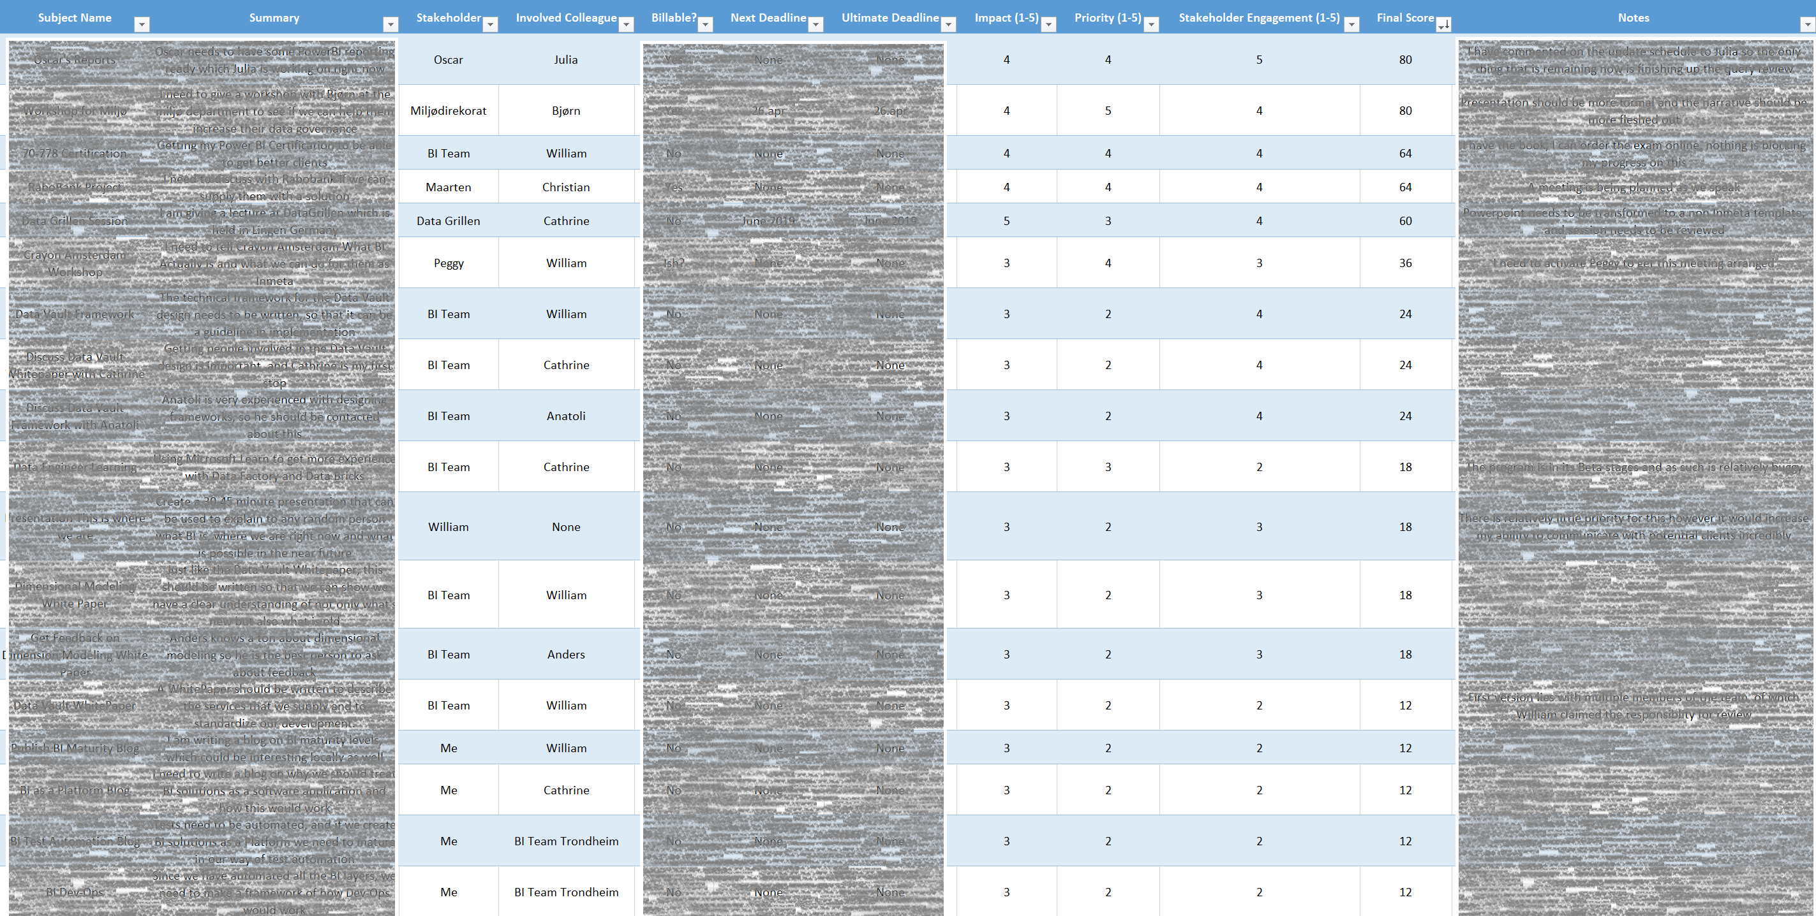
Notes:
Explaining the exmple of my personal live doc, making a personal planning that can be discussed with stakeholders
Works the same for requirement documentations or the previously used prototype
37:35

Slide 20

Pillar 4: Live Docs
Live Docs are the WD40 of stakeholder management
Notes:
Explain the ease of stakeholder communication
Explain the ability to share responsibility between developers and business users to get the designs and goals up and running
Explain that this decreases the end of the road finger pointing and bitterness
39:35

Slide 21
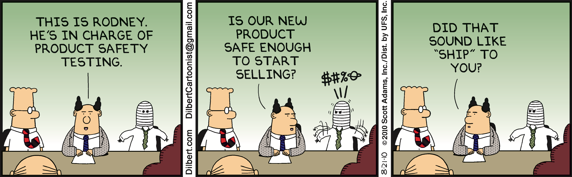
Pillar 4: Live Docs
Blurring the line between Business and Development
Notes:
Explain the positive applications of live documentations and not just the «covering your ass»
Enhancing the willingness of the business to push for refactoring/working on technical debt
Pushes developers to think business allowing the developers to understand the business needs and deliberations
41:05

Slide 22
Pillar 5: TDD/BDD
Pillar 5: Test/Behaviour Driven Development (TDD/BDD)
Notes:
Explain the desire to make requirements explicit vs implicit
Test driven development sets these unambiguous technical requirements that can only be completed or incomplete
Behaviour driven development is the test case that leads to one piece of delivered behaviour
These are satisfied by the Technical test cases
43:05

Slide 23
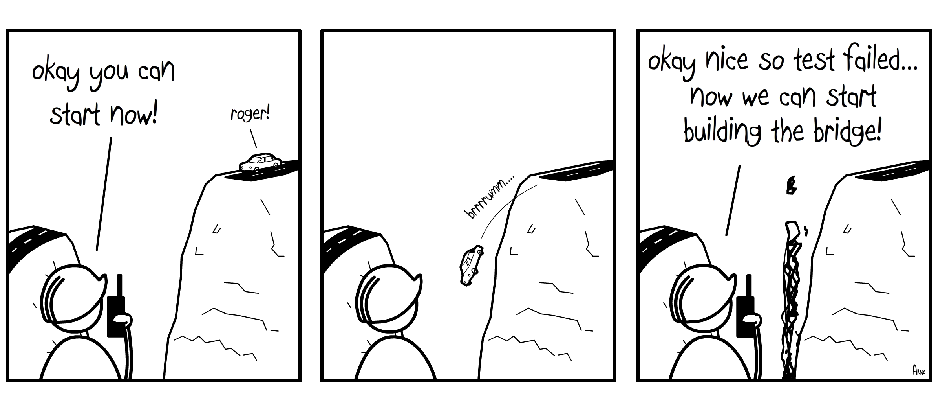
Pillar 5: TDD/BDD
Why do we need to use TDD/BDD
Notes:
Desire to make what needs to be developed explicit
Make sure that no «extra» features are being developed that are not requested by the business
Give a quality assurance for everything that is developed since it satisfies the aforementioned test case
If the user needs more constraints or exceptions for certain situations these will need to be described in test cases
This avoids vague ambiguous requirements that are open for constant debate
45:05

Slide 24
Behaviour | Technical Test
The HR table needs to contain the following aggregated fields per year: Revenue Profit Cost | Product cost needs to be made available in the Product Staging Database
 | Revenue information needs to be made available in the Finance Staging Table
 | Product cost and Revenue need to be available in the Integration Layer
 | The data model must allow aggregation per year
 | The data model must subtract Cost from Revenue to create Profit
… | …
Notes:
Simple example
Note that this example is far from perfect, for example:
The Behaviour is too broad
Technical tests not only describe the technical specifications but also KPI generation
Potential for repeating specifications?
47:05

Slide 25

Pillar 5: TDD/BDD
Why is TDD/BDD so much more difficult for BI?
Notes:
Note the difference in happy flows between for example a website and a BI system
Team size, speed of delivery and complexity of deliveries
Our tools allow us to abstract from code to such a degree that we work in a very business like language
It is too easy to develop functionality, and thus we don’t want to focus as much on the administration
We lack a standardized delivery flow!
49:05

Slide 26
Pillar 6: Development Process
Pillar 6: Development Process How and Why
Notes:
By standardizing our ways of working we create frameworks that can be improved upon
Other areas of development this is already more matured
We need a development strategy that reinforces the Agile Mindset
51:05

Slide 27
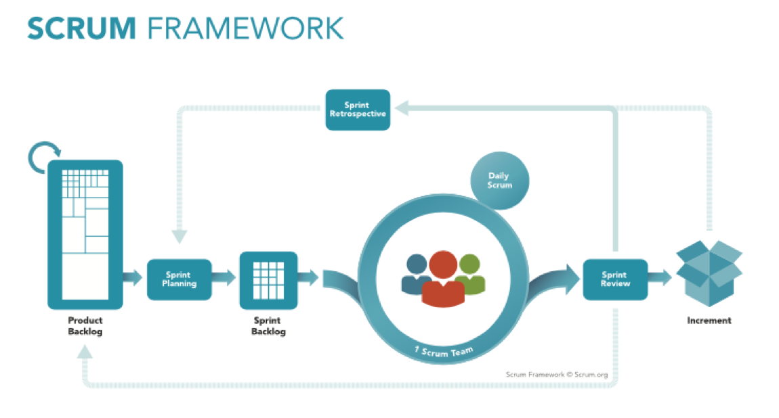
Notes:
Explain scrum framework
Explain the importance of reviews
Explain the importance of retrospective
Explain sprint planning and delivery expectation
53:05

Slide 28
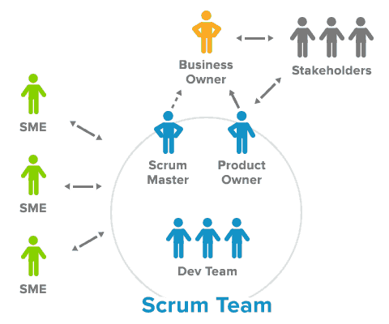
Pillar 6: Development Process
What are the responsibilities of the members
Notes:
Explain T-Shaped development team
Explain the role of the product owner
Explain the role of the Stakeholders
Explain the role of the Scrum Master
55:05

Slide 29
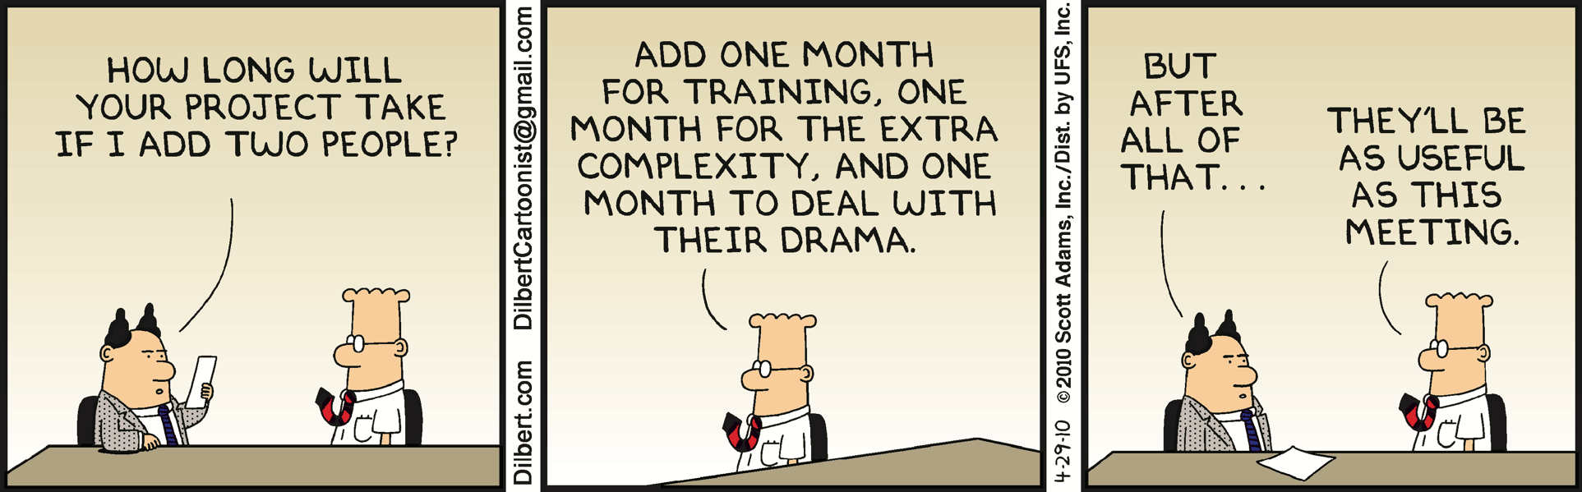
Pillar 6: Development Process
Limitations of small BI teams and how to mitigate them
Notes:
Upside of small teams is easier cooperation
Big downsides though
Often missing a Product owner and a Scrum Master so the development team needs to become even more T-Shaped
Encumbering administration by having to do a lot of documentation that needs to be communicated internally
Potential solutions
Extreme programming principles, having multiple people work on a single delivery behind a single PC
PO is covered for a large part by having ambassadors and very involved development team members
Document the explicit requirements of the business, Create a LIVE decision document to communicate how these requirements were fullfilled
Don’t fret too much about backlog, focus on one or two pieces of delivery per sprint that can be ticked off during the review
Get an external tester involved ASAP, this person will need to be able to create test cases based on the requirements on the table and should extract information from the business
This person will start to function partly as a PO, but ONLY to enhance existing requirements and NOT to define the requirements
57:05

Slide 30
Conclusion time!
Summary of all the pillars
Agile Mindset
So we can stay High Performing
Accessible Prototyping
So that we have a clear goal
Isolatable Development
So that we deliver predictable value every step of the way
Notes:
Summarize
Mindset for staying persistently high performing
AP for deliberating designs and goals with the business
ID to make everything testable and to increase quality
Live docs to stay communicated with the business
TDD/BDD for quality assurance and diminish sidetracking
Development Process for a consistent workflow
58:05

Slide 31
Conclusion time!
Summary of all the pillars
Live Docs
So we are always in touch with the business
TDD/BDD
So that we stay efficient
Development Process
So that we work with a framework
Notes:
Summarize
Mindset for staying persistently high performing
AP for deliberating designs and goals with the business
ID to make everything testable and to increase quality
Live docs to stay communicated with the business
TDD/BDD for quality assurance and diminish sidetracking
Development Process for a consistent workflow
59:05

Slide 32
Conclusion time!
3 Things to take from this:
Openness and constant communication are top priorities
Make it that every piece of functionality as concrete value for your stakeholders
Document agreements, redesigns and notes to have a consistent group conscience in the project
Notes:
Summarize
Mindset for staying persistently high performing
AP for deliberating designs and goals with the business
ID to make everything testable and to increase quality
Live docs to stay communicated with the business
TDD/BDD for quality assurance and diminish sidetracking
Development Process for a consistent workflow
60:05

Slide 33

Session Feedback Day 1
http://bit.ly/DataGrillen2019Day1

Slide 34

Event Feedback
http://bit.ly/DataGrillen2019Event

Slide 35
Pillars of Agile BI The journey to high performance BI Development
@Jbosems donedifferent.data.blog

